Slide 1

Game N' Watch
Video Game Tracking Application
John Reese
Benjamin Roux
Andrew Storrow

Slide 2
Features
Lists existing and upcoming video games
Supports all major gaming platforms
Tracks games of interest to users
Allows friends list behaviors
Detailed reports by genre, platform, or developer
Gathers sales and financial statistics

Slide 3
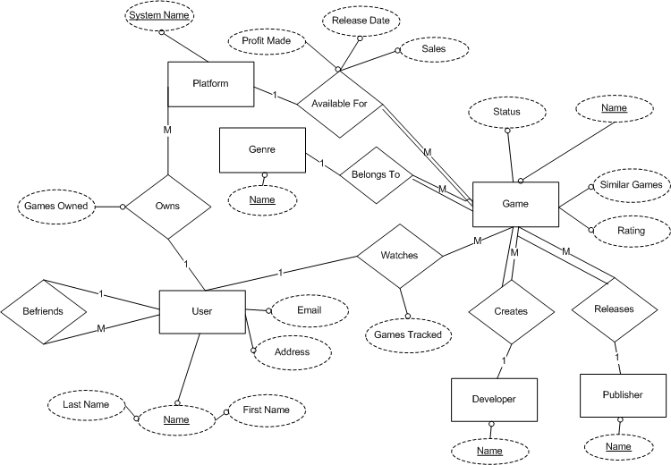
ER Diagram

Slide 4
Technology
Three-tier web application
Cross-platform implementation
Java Spring Framework
  Spring MVC webpages hosted by Tomcat
  Spring RMI backend services
  Integrated JDBC communication with DBMS

Slide 5
Risk Management
Uptime
  System must withstand high concurrent users
  Minimal downtime
User Securities
  Data is securely stored
  User information not open to 3rd parties

Slide 6
Game N' Watch
Questions, comments, or concerns?

